Slide 1
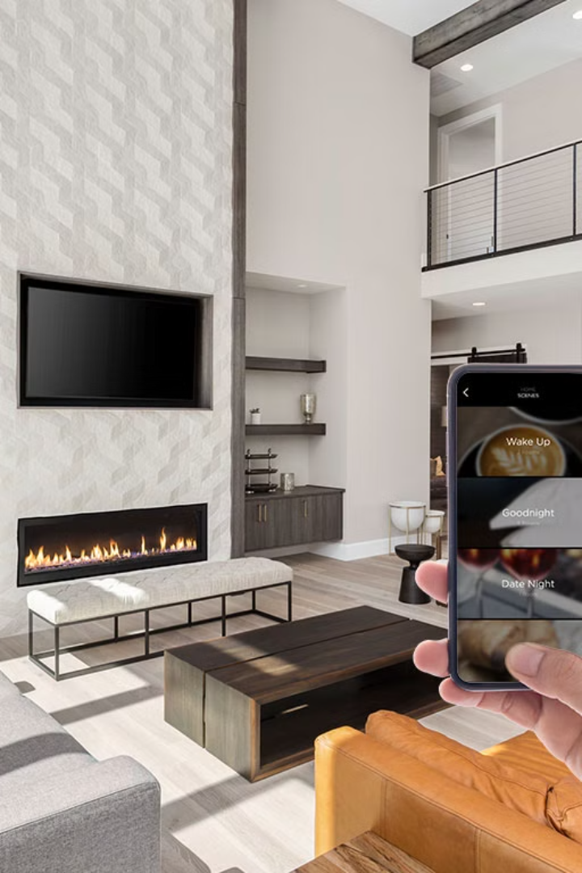
Adaptive Smart Walls – The Future of Smart Living
Domain: Integrating IoT and AI for Intelligent Living Spaces
By -
2320030038-G Padamaja
2320030126-R Nanda Kishor
2320030126-Y Vignesh Reddy

Slide 2
Abstract : Adaptive Smart Walls
Definition: Intelligent surfaces changing color, texture, and functionality based on environmental inputs.
Objective: Enhance user experience, energy efficiency, and interactivity in modern homes.
Key Features: E-Ink displays, temperature control, soundproofing, augmented reality integration.
Revolutionizing interior design with dynamic surfaces and automated responses

Slide 3

Understanding Adaptive Smart Walls
1
Core Components: Sensors, Microcontrollers, Actuators, and Smart Materials
2
Key Technologies: IoT (Internet of Things): Connectivity for real-time data exchange. Market size $933.62 billion in 2023, projected to reach $2,465.26 billion by 2030.
3
AI (Artificial Intelligence): Algorithms for predictive and adaptive behaviors. AI market in smart homes projected to grow at a CAGR of 25% from 2024-2029.
4
Smart Materials: E-Ink, electrochromic glass, and shape-memory alloys
Integration of hardware and software for seamless operation
Dynamic adjustments based on user preferences and environmental conditions

Slide 4
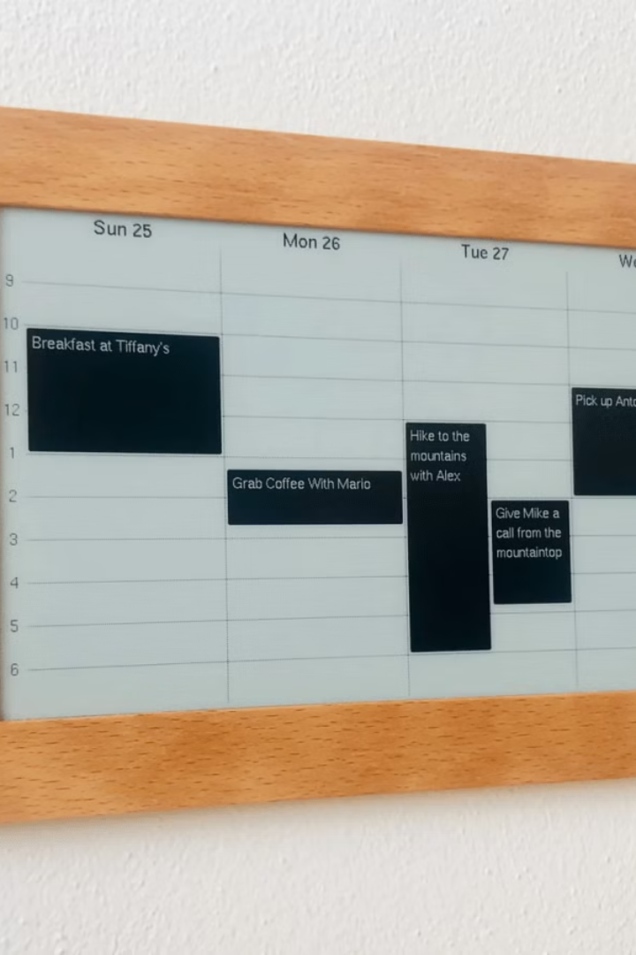




Key Features & Functionalities
E-Ink Displays: Customizable digital art, dynamic information panels. Estimated E-Ink display market reaching $4B by 2027.
Temperature Control: Integrated thermoelectric modules for zonal climate management. Potential energy savings of up to 30% compared to traditional HVAC systems.
Soundproofing: Active noise cancellation using piezoelectric materials. Reduces external noise by up to 40dB.
Augmented Reality Integration: Interactive overlays for immersive experiences. AR market in home applications projected to reach $5.3B by 2028.
Ambient Lighting: Dynamic lighting based on user activity and time of day. Improves mood and reduces eye strain by up to 60%.

Slide 5
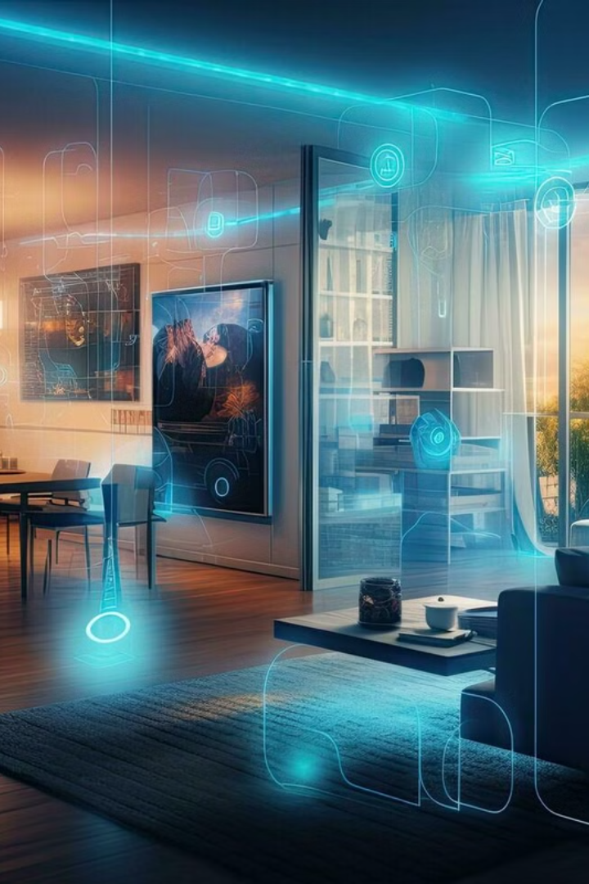
Benefits of Adaptive Smart Walls
Enhanced User Experience
Personalized and intuitive living spaces
Energy Efficiency
Reduced energy consumption through intelligent climate control
Increased Property Value
Modern and innovative feature appealing to tech-savvy buyers. Smart homes can increase resale value by up to 5%.
Improved Comfort
Optimized environment based on individual preferences
Cost Savings: Lower energy bills and reduced maintenance costs

Slide 6
Future Developments
Self-healing materials for automatic repair. Self-healing polymers market projected to reach $2.3B by 2029.
1
2
Integration with AI-powered virtual assistants for voice control
Advanced sensor technologies for predictive maintenance and personalized settings
3
4
Wireless power transfer for reduced clutter. Wireless power market projected to reach $26B by 2030.
Biometric authentication for enhanced security
5

Slide 7
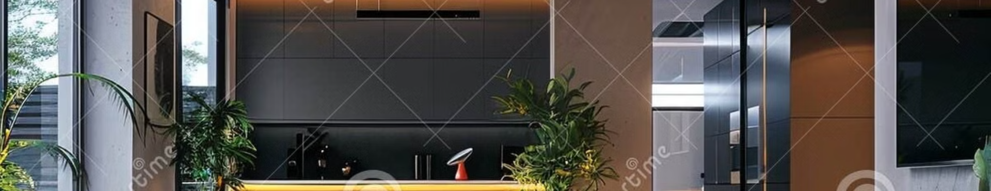
Conclusion: The Future is Here
Adaptive Smart Walls offer a new paradigm for intelligent living spaces.
Combining IoT, AI, and smart materials to create dynamic and personalized environments
Poised to transform modern homes, improving user experience, energy efficiency, and overall quality of life
Investment Opportunity: Be a part of the future of smart living with Adaptive Smart Walls

